Slide 1
Progress on ASM Formalisation – Southern Zambia
Dickson Banda
15th April, 2024

Slide 2
Outline:
1.0 Take home from 2018 Mosi-Oa-Tunya Declaration, Livingstone (ASM18)
2.0 Our Realisation from ASM18!
3.0 What did we DO? / What are we Doing?
4.0 Performance Trends; ASM Formalisation - Cooperatives & AMRs
5.0 Lessons Learnt

Slide 3
1.0 TAKE HOME FROM MOSI-OA-TUNYA DECLARATION, LIVINGSTONE (ASM18)
Formalization
Recognise that for any society to maximize the positive impact of an economic activity, ASM inclusive, it must be formalized, responsible and well governed.
Integration of ASM into Local, National, Regional and International Supply Chains
Emphasise that informality along the whole supply chain impedes the sustainable development of ASM and call on the private sector and relevant stakeholders along the supply chain to work together for a formalized, profitable, inclusive and responsible sector and for governments to put in place an enabling business operating environment.

Slide 4
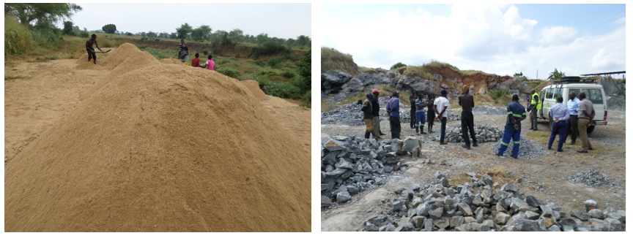
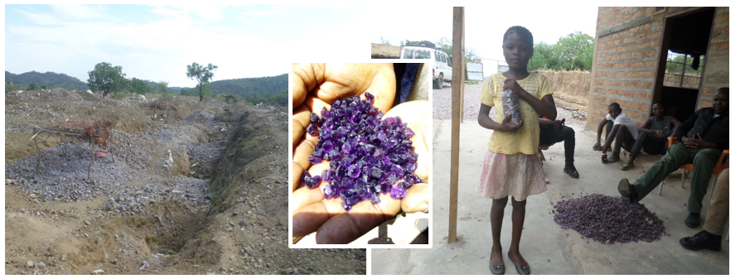
2.0 OUR REALISATION FROM ASM18 – MOSI-OA-TUNYA DECLARATION
We realized that:
(a) There was very low local participation on ASM (on record); in other words,
2020 – Informal Sand mining & Quarrying in Mazabuka District
(b) Local communities were participating in ASM, but informally
2021 – Informal Amethyst mining & Trading – Zimba District

Slide 5
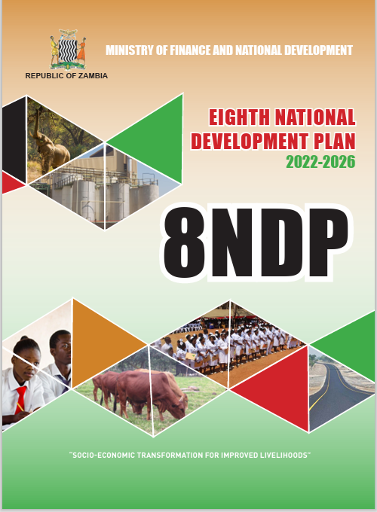
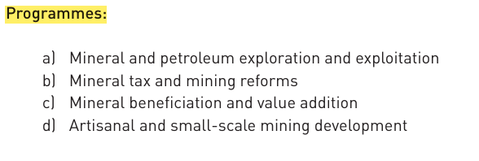
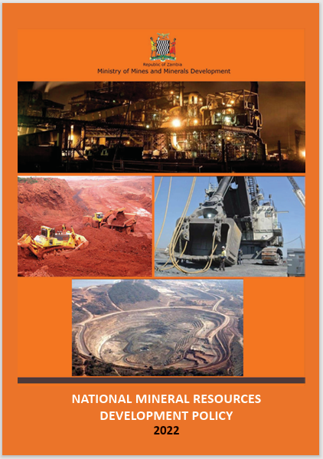
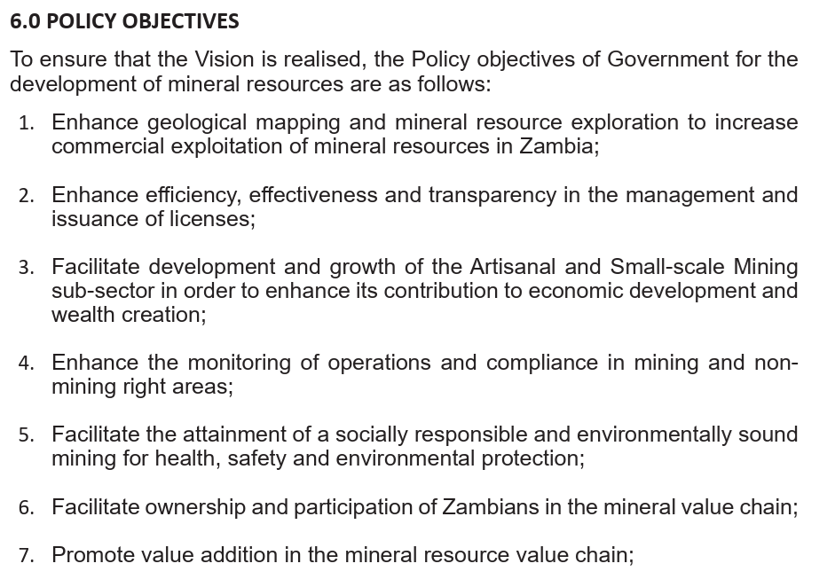
3.0 WHAT DID WE DO? / WHAT ARE WE DOING?
Inspired & Guided BY:

Slide 6
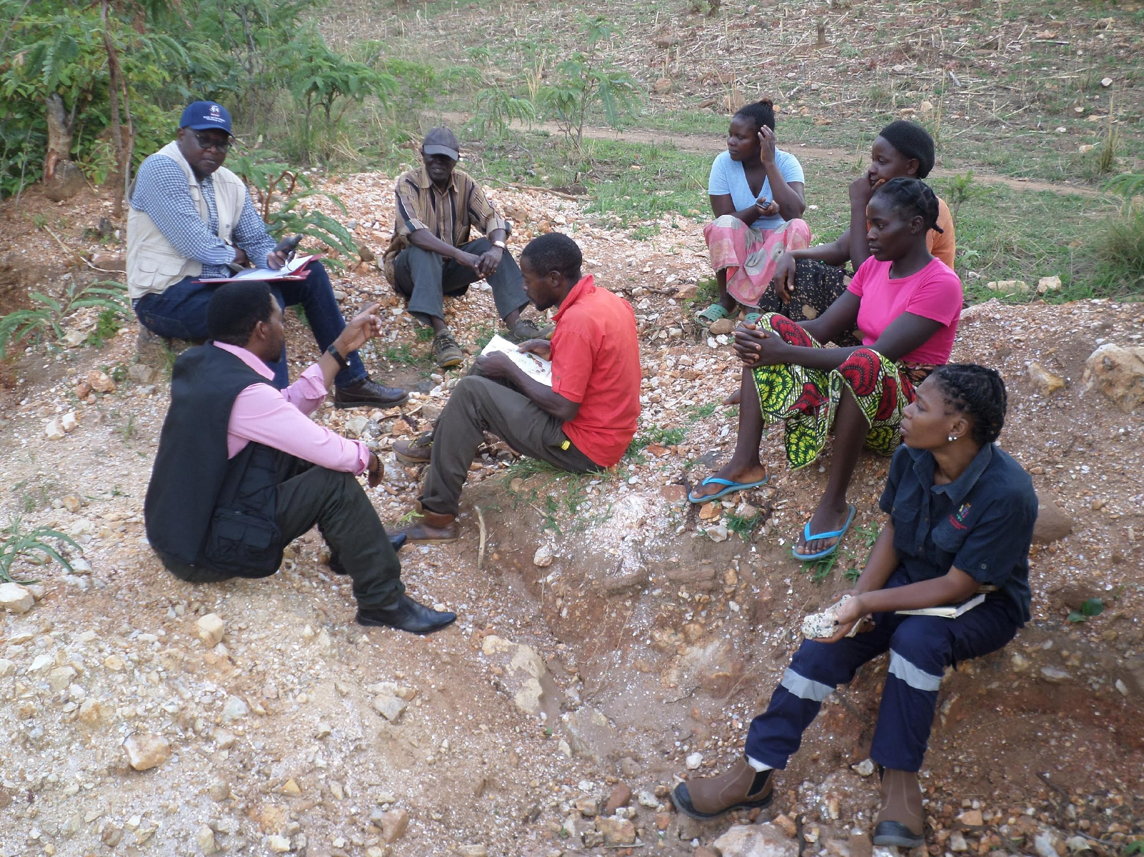
WHAT DID WE DO? - Southern Province, Zambia
3.1 Identification of existing informal ASM sites and levels of participation; Site visits and Stakeholder engagement
40 existing sites were identified with over 3,700 local community members engaged in informal ASM of development minerals; 53% women
3.2 Stakeholders Consultation & Collaborations
Government line ministries and departments; Ministry of Small & Medium Enterprise Development (MSMED)-ministry responsible of cooperatives.
Civic Leaders, Local Authorities, Civil Societies
Traditional Chiefs and Leaders
3.3 ASM Formalisation & Cooperatives Sensitisation
In collaboration with MSMED
2023 – Sensitisation in collaboration with MSMED

Slide 7
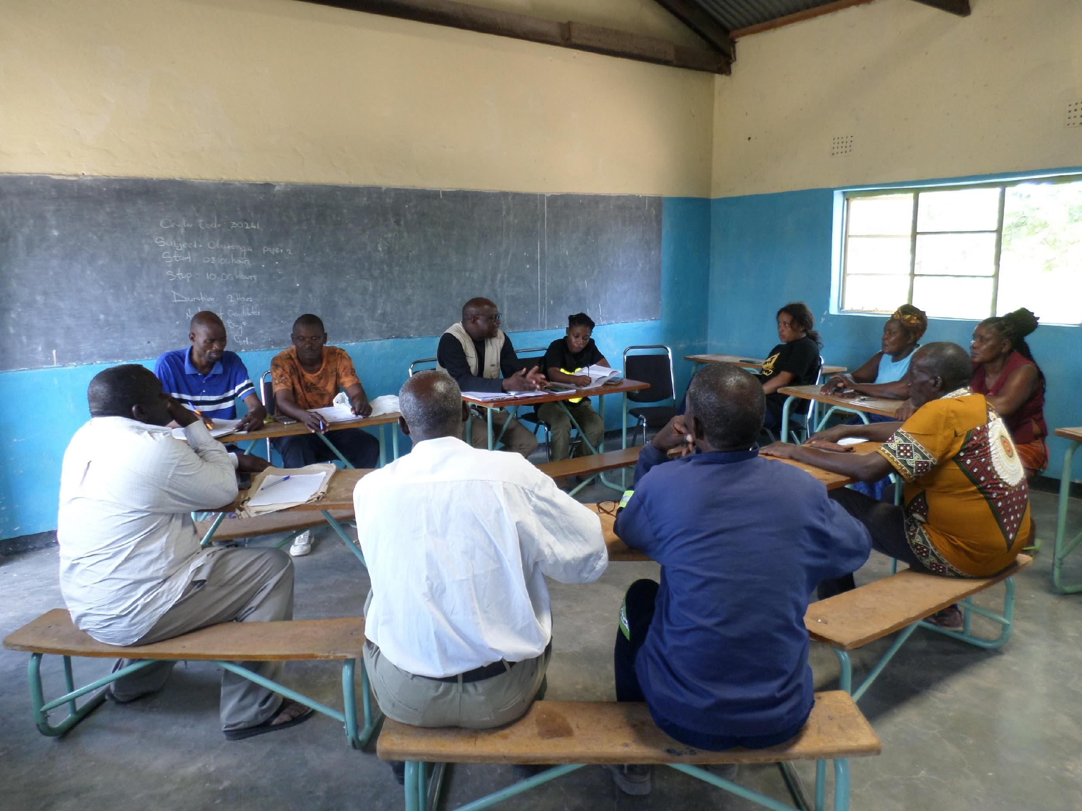
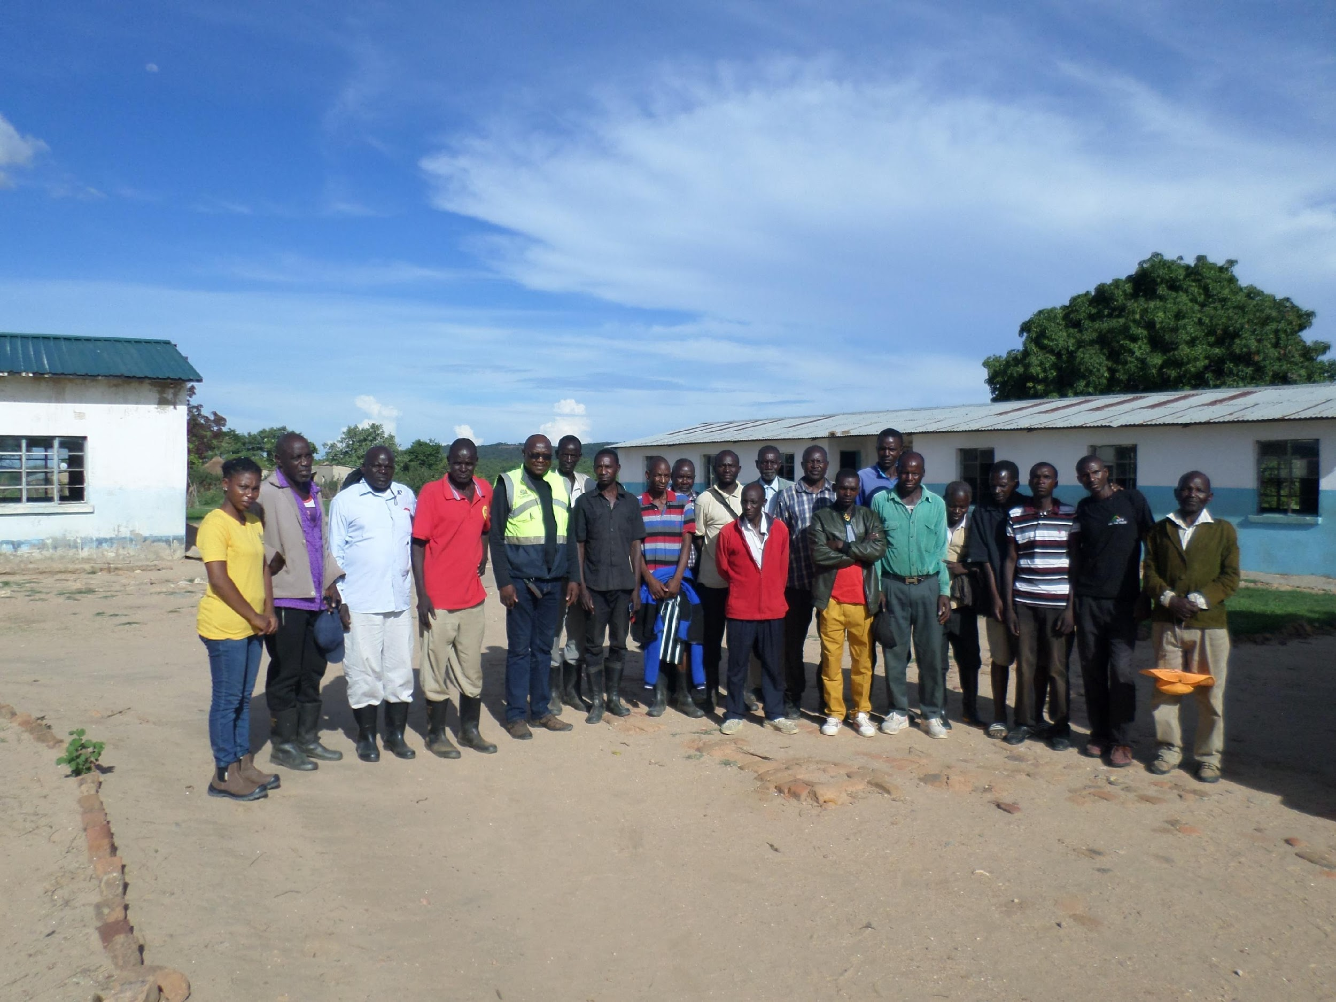
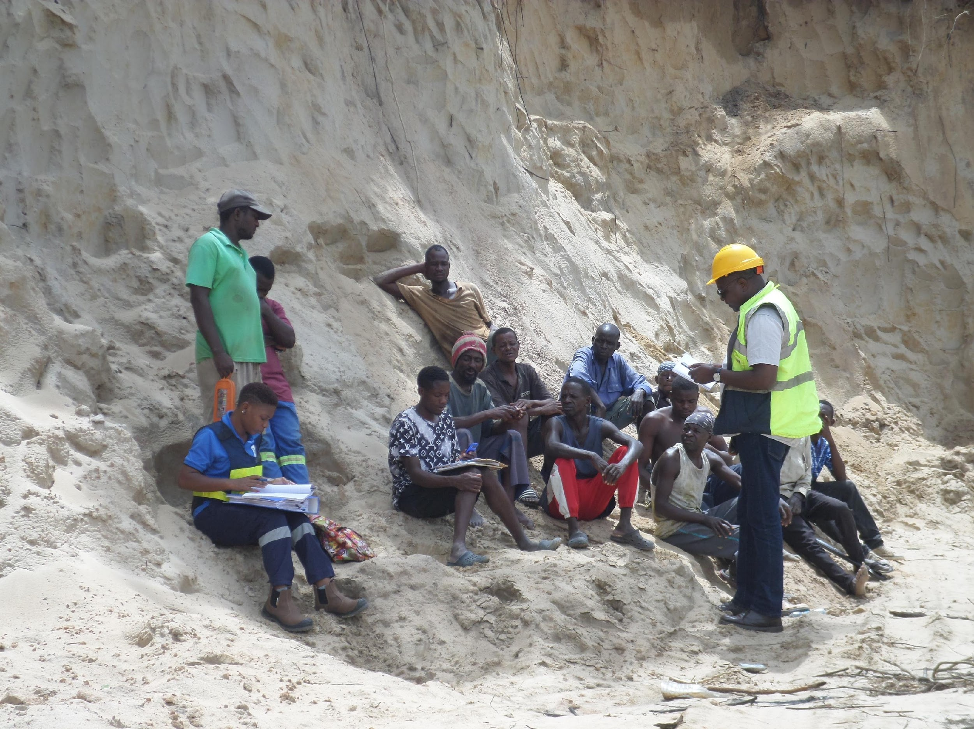
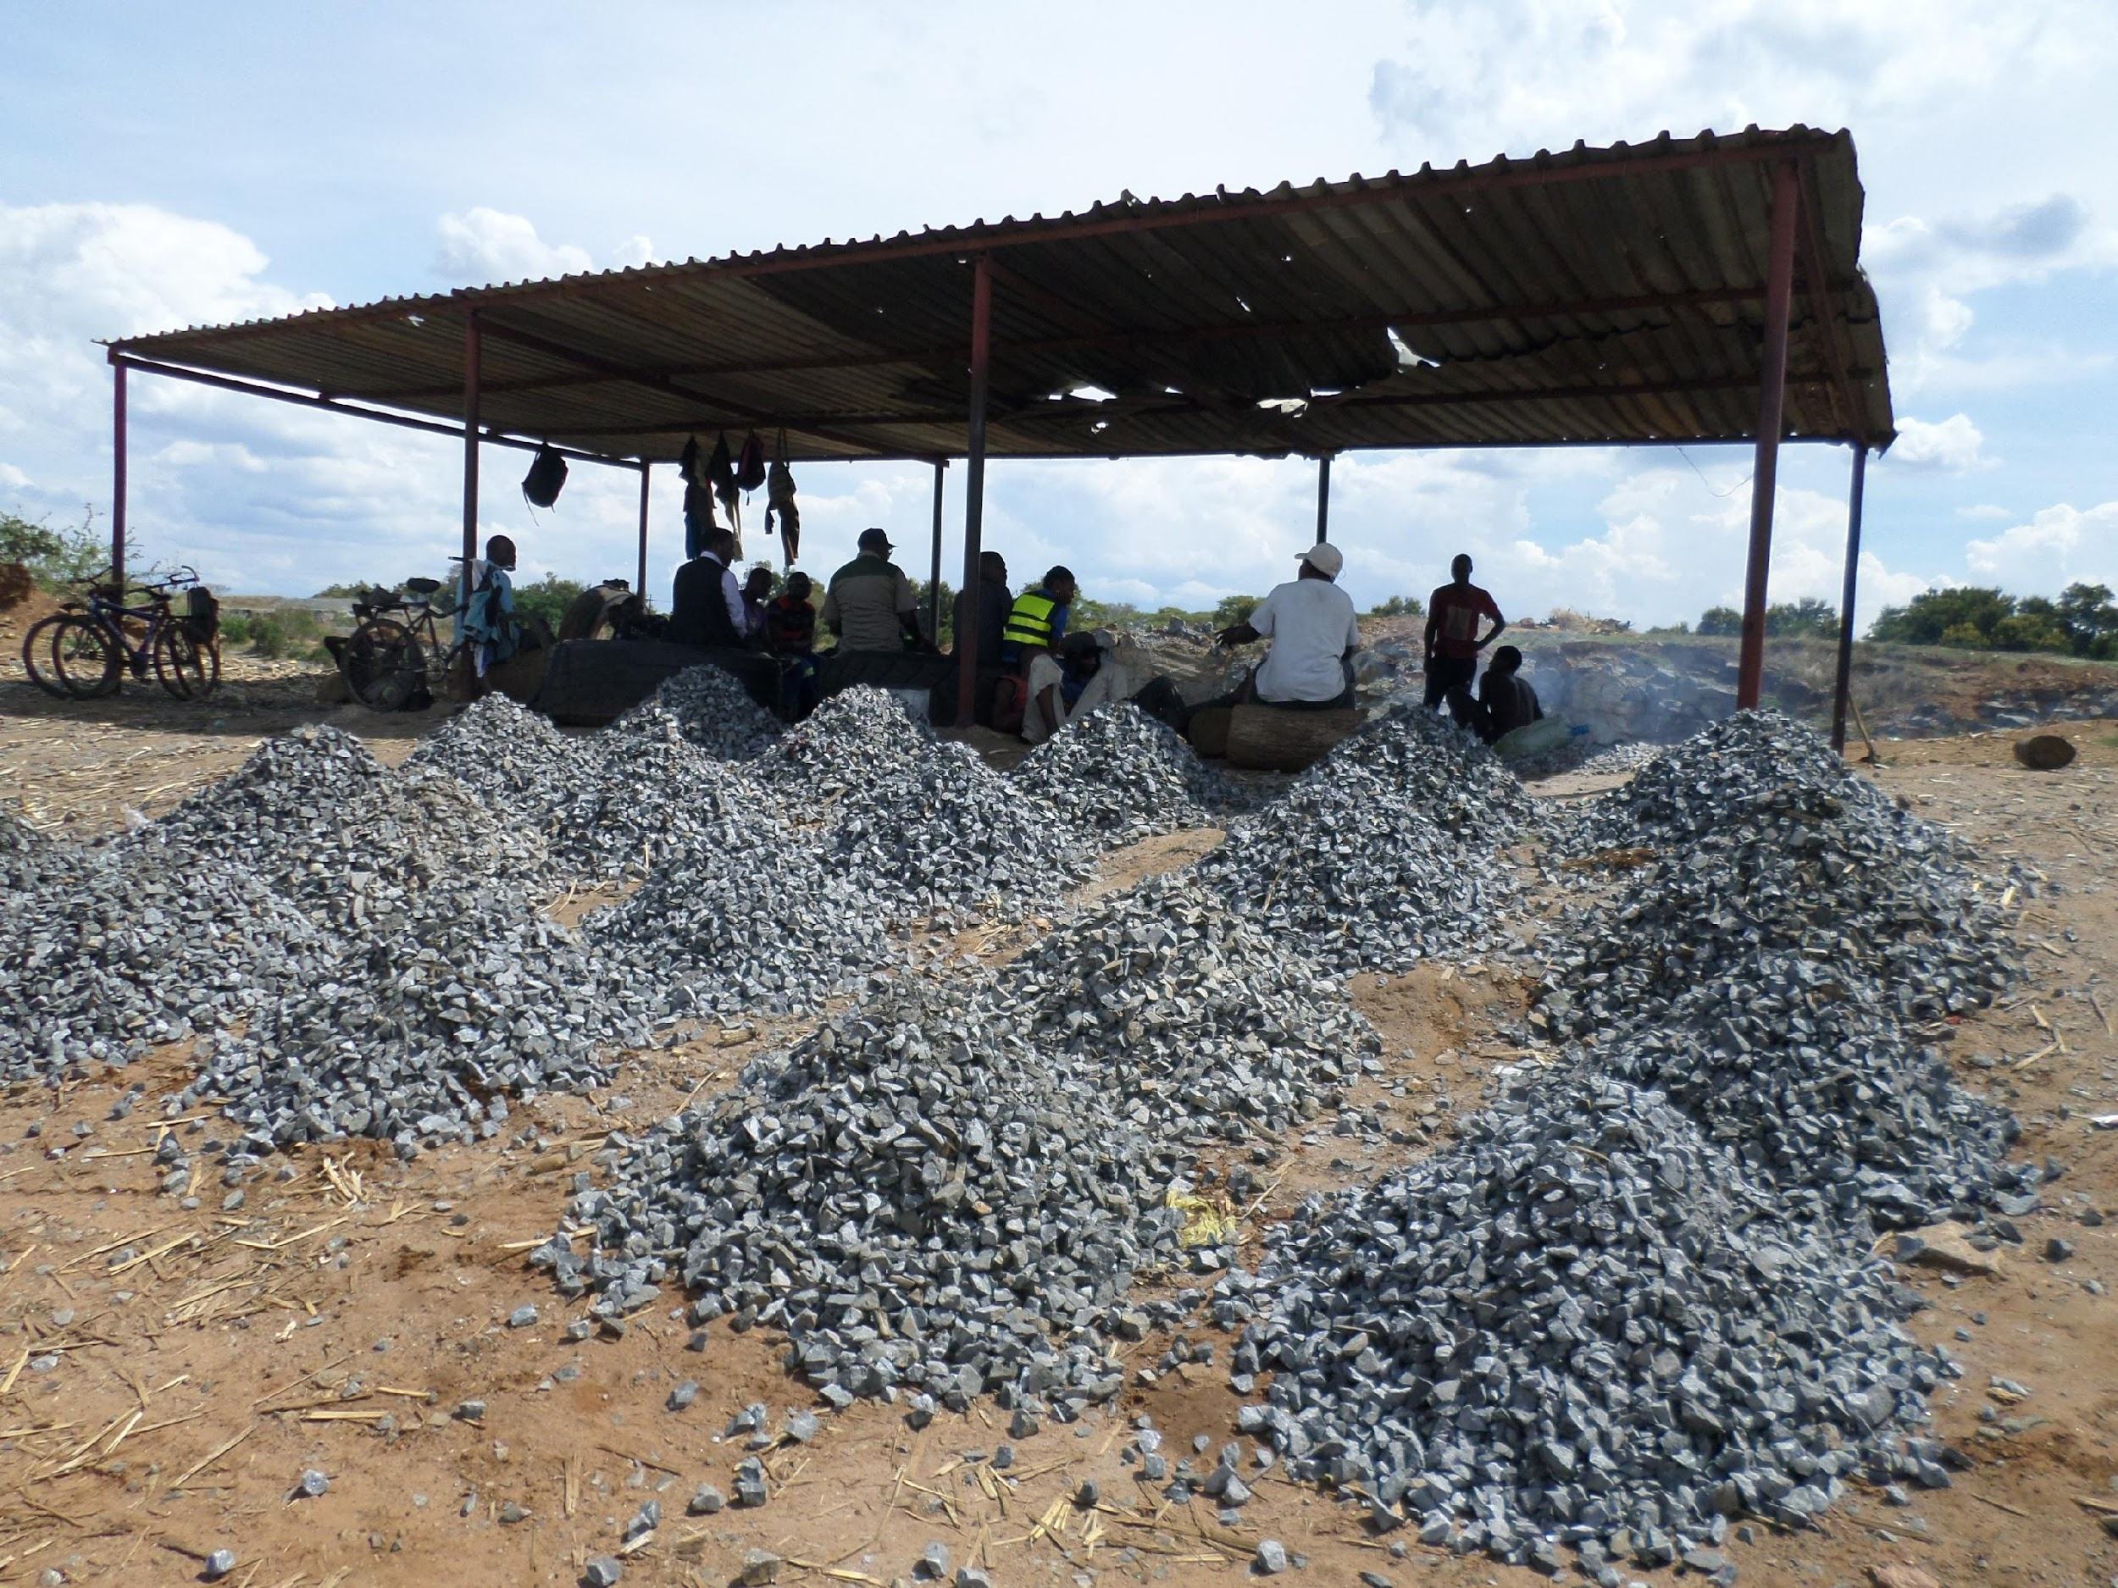
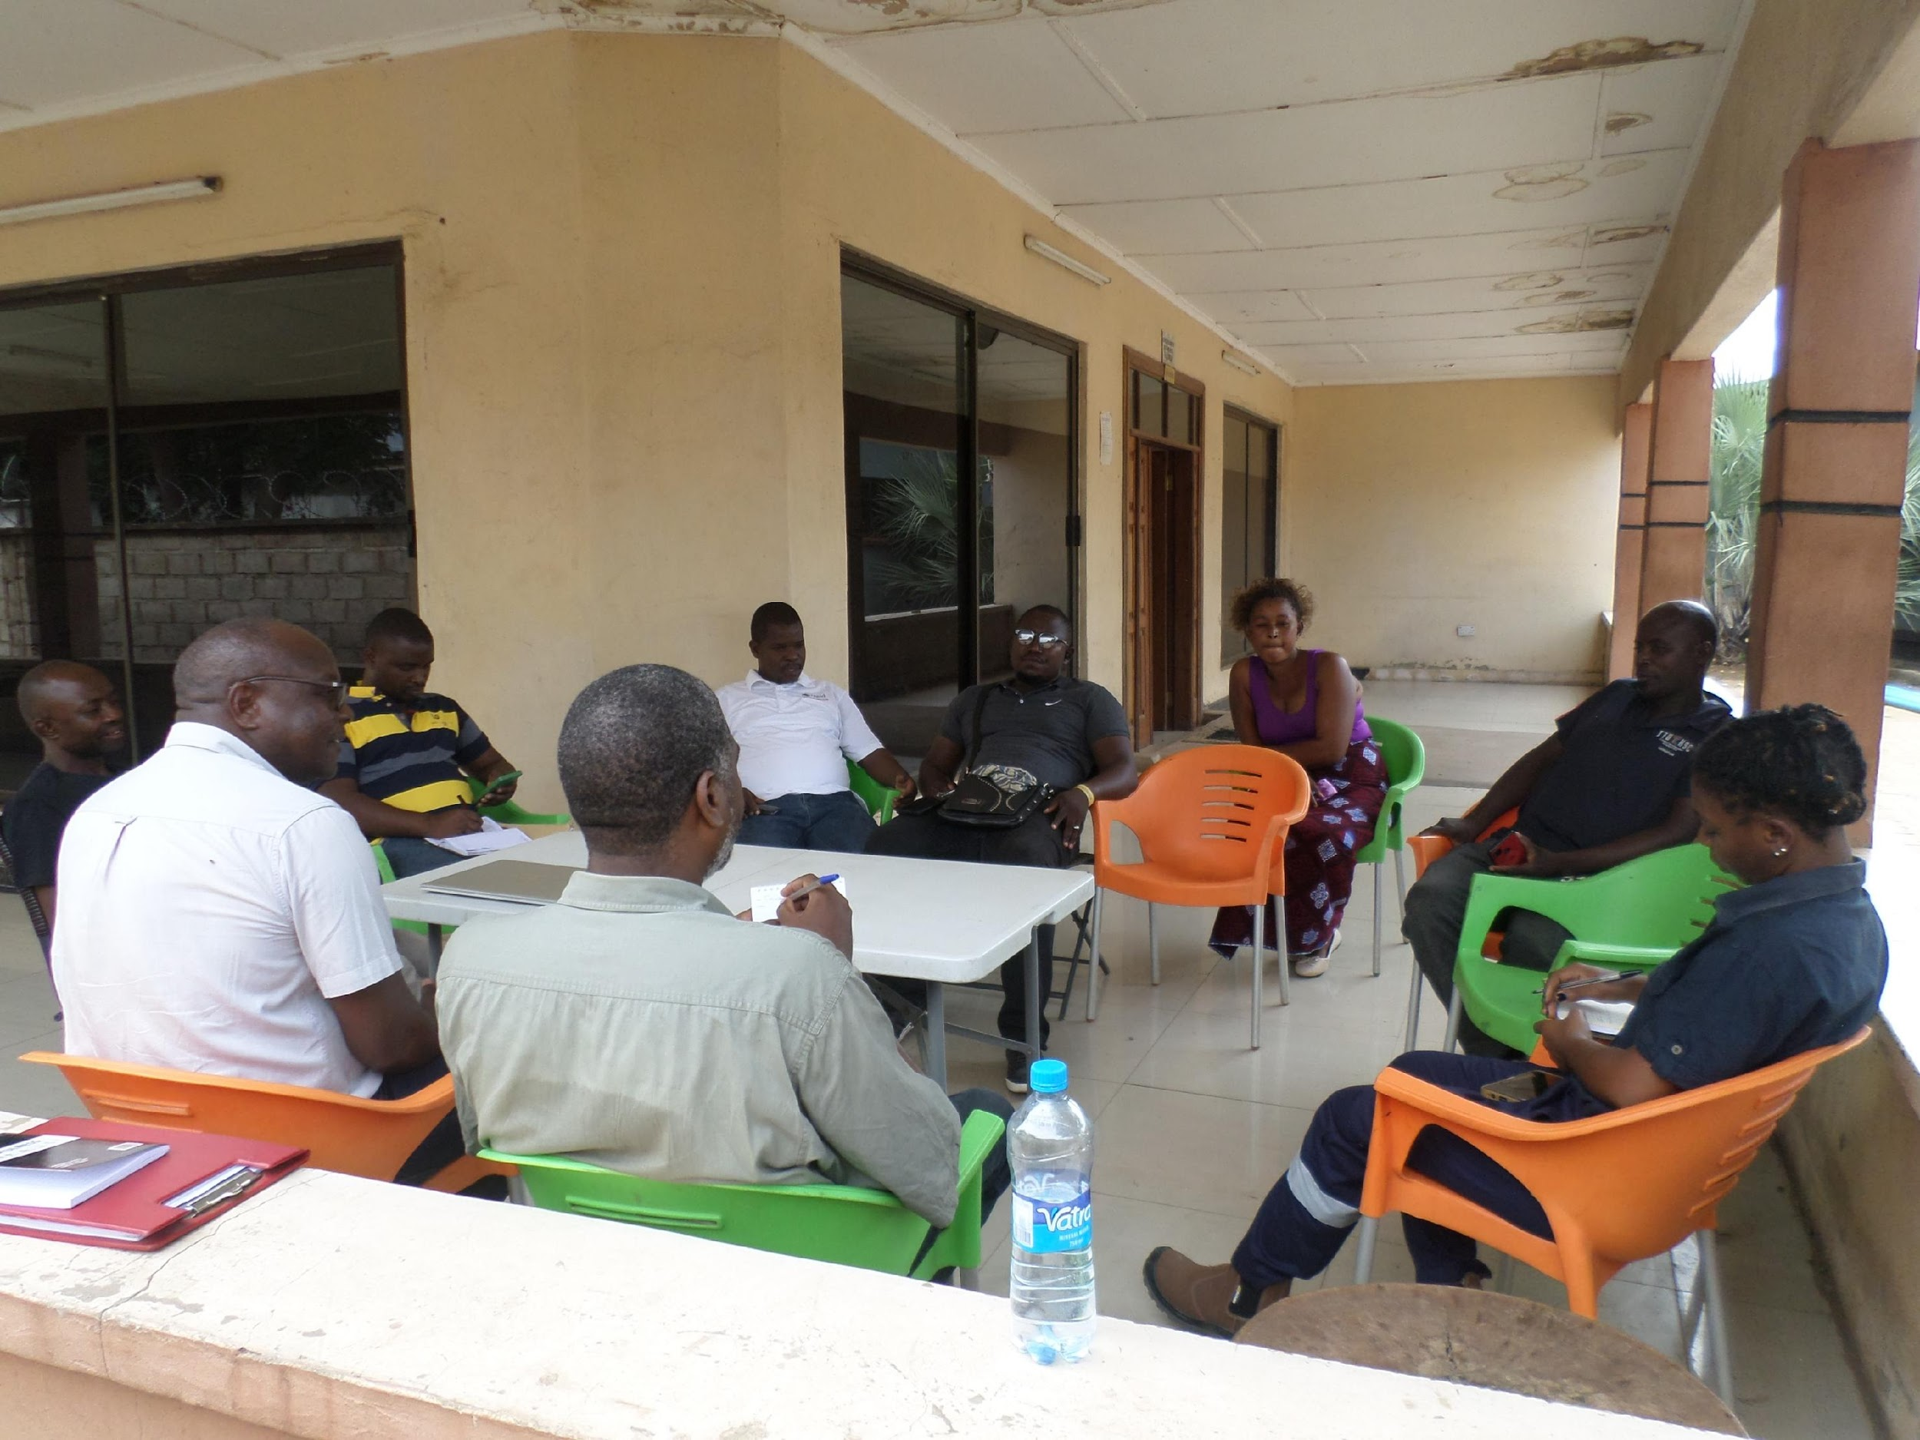
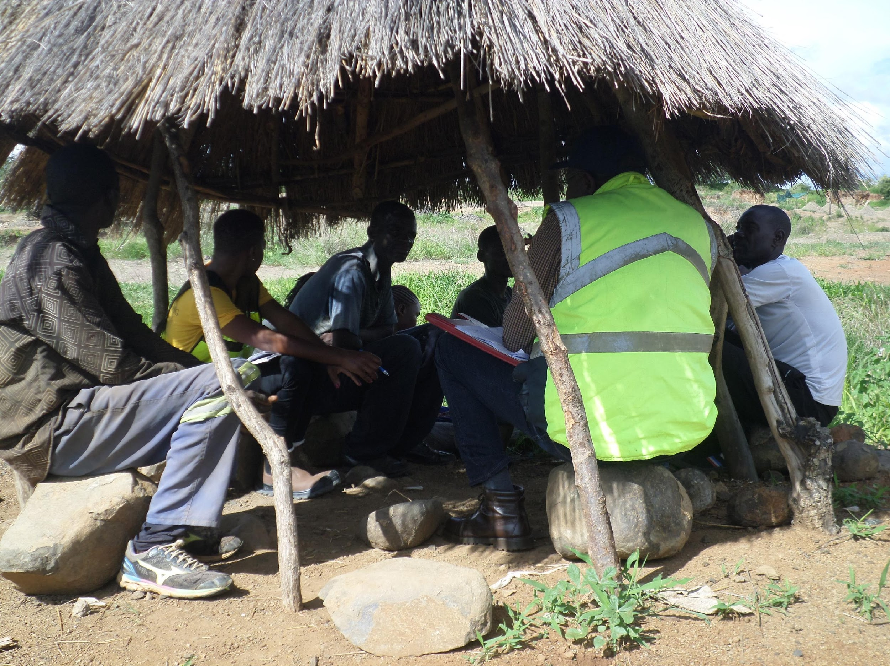
WHAT DID WE DO? - Southern Province, Zambia
2023 – Cooperatives Sensitisation in collaboration with MSMED

Slide 8
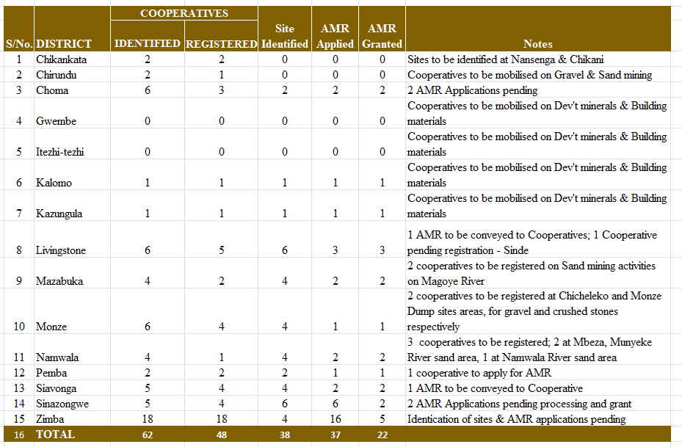
4.0 Performance Trends; ASM’s Cooperatives & Artisanal Minin Rights (AMRs)
Aspiration and target inspired by the 8NDP and National Mineral Resource Development Policy - 2022
27 ASM Cooperatives to be registered by 2026 (11 at close of 2023), of which 50% be granted AMRs
ASM Formalisation Status – At Close of 2023
A total of 62 Cooperatives / groups have been identified, out of which 48 cooperatives have been registered, with certificates. A total of 37 AMR applications lodged, and 22 AMRs granted.
92 dedicated development mineral sites have been identified in respective districts for ASMs’ participation in infrastructure development projects

Slide 9
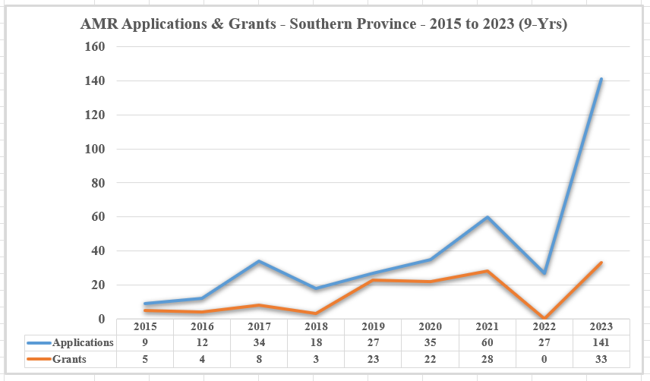
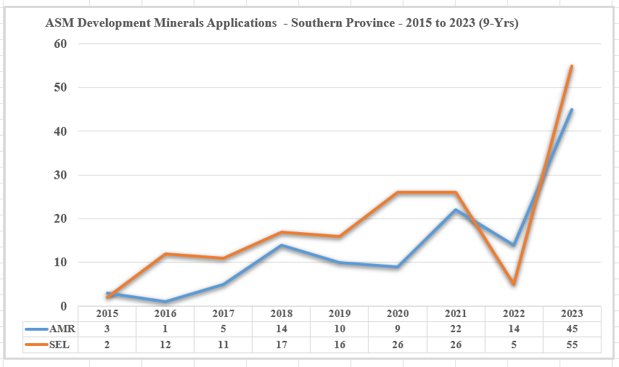
Performance Trends; ASM’s Cooperatives & Artisanal Minin Rights (AMRs)
Mining Right Applications by ASMs and Grants
AMR & SEL Applications –Development minerals
Note: (1)AMR – Artisanal Mining Rights
(2)SEL – Small-scale Exploration Licence
(3) 2022 – Mining cadastre moratorium

Slide 10
5.0 LESSONS LEARNT
(1) Lack of funds by ASMs negatively impacting formalization process; failure to meet the cost of registration of cooperative / application for Artisanal Mining Right and other statutory requirements.
(2) Lack of ICT or reliable ICT in some rural area negatively impacting ASM formalization process; failure by ASMs to easily access on-line application services for both Cooperative & AMR application
(3) There is limited available spatial space on the mining cadastre system for ASM’s mining right applications; ASM have to compete with everyone else for space.
(4) There is now increased awareness on the need for ASM formalization on development minerals in the province.
(5) There is still need to build capacity in cooperative governance, Safety-Health-Environment Management, Geology and basic mining technics.
(6) There is need create market linkages for the ASM cooperatives / collaboration among ASMs
“Walk the Babies through the Valley” – Establish models

Slide 11
THE END
THANK YOU FOR YOUR ATTENTION

