Slide 1
Consultative Workshop towards an ASM Continental Strategy – South-South Cooperation and Knowledge Sharing Forum
Simukali Mulongwe
Country Coordinator – Zambia
ACP EU Development Minerals Programme
April 15 – 19, 2024 – Radisson Blue, Lusaka-Zambia

Slide 2
Introduction
Perception about ASM sector – by default regarded as informal (illegal)
Fact about ASM
Neglected sector in many countries – its production poorly or unaccounted for. ASM contributions to mainstream economy unquantified
Employees millions of people especially at the community level
ASM Informal activities are taking place various parts of Africa
Mineral discoveries made by the ASM
Possible Reason
High levels of unemployment
Poverty
Natural Disasters for example drought

Slide 3
GRZ Position on ASM
Unlike other jurisdiction, in Africa or World, the MMMD Act takes cognisant of ASM existence
Both old and new National Development Plants emphasised
Formalisation of ASM key to organising the sector
Dedicated department to be established to focus– New structure
Setting up of ASM minerals market

Slide 4
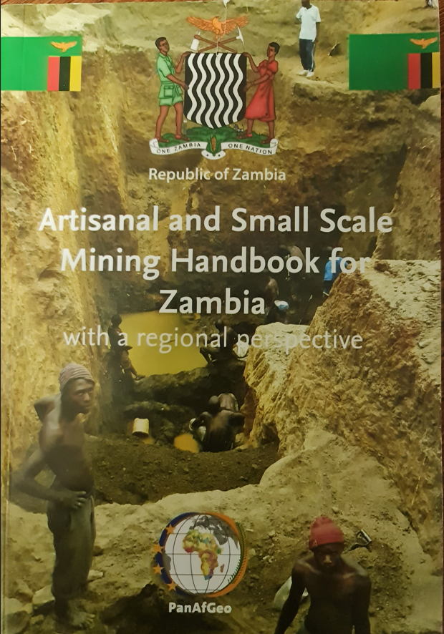
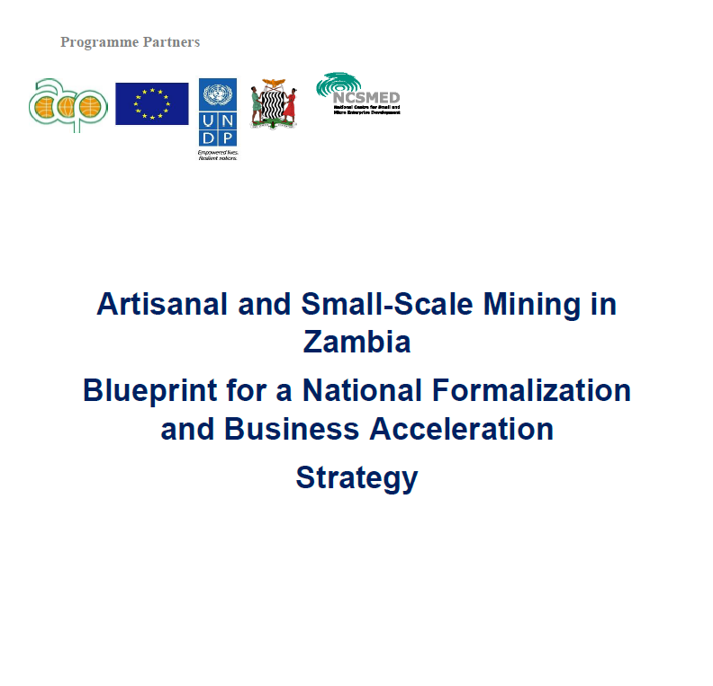
Programme Achievements
On legal and institutional environment:
Built capacities of artisanal miners and government agencies
Fostered formalization and forming of artisanal mining cooperatives
Conducted studies
Geo-data digitization

Slide 5
Formalisation of ASMEs
Major key to organizing the ASM sector
Formalization can be categorized into three stages:
STEP 1
Social formalization:
Formation of associations or cooperatives
STEP 2
Legal formalization:
Completion of
necessary gov. requirement
STEP 3
Market formalization:
Integration into formal market economy

Slide 6
Implementation Plan for Formalization of ASM
In order to systematically implement the blue print
Using the regional mining bureaus, a plan developed
Identification of sites
Generated database (Living documents) and plan
Teams formed to support the exercise
Cooperatives and Business Development officer
Team Composition
Cadastre officers, Geologists, Mining Engineers
ASM - Associations
Local and Traditional Leaders

Slide 7
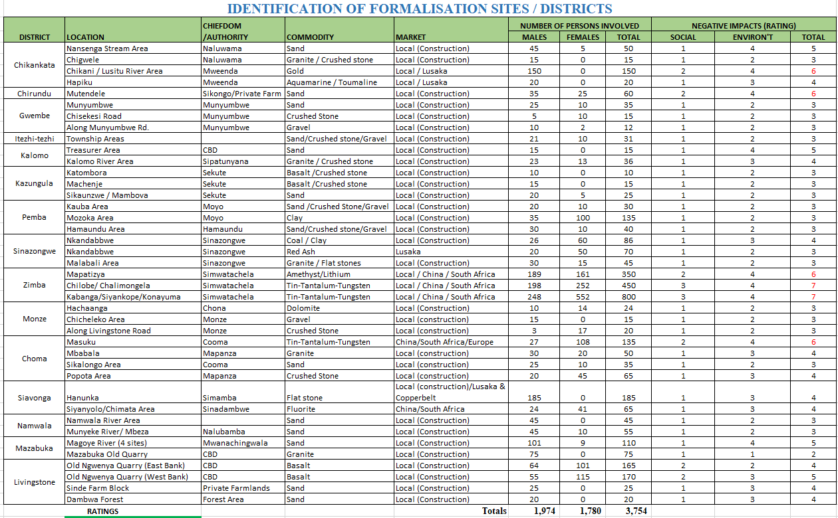

Slide 8
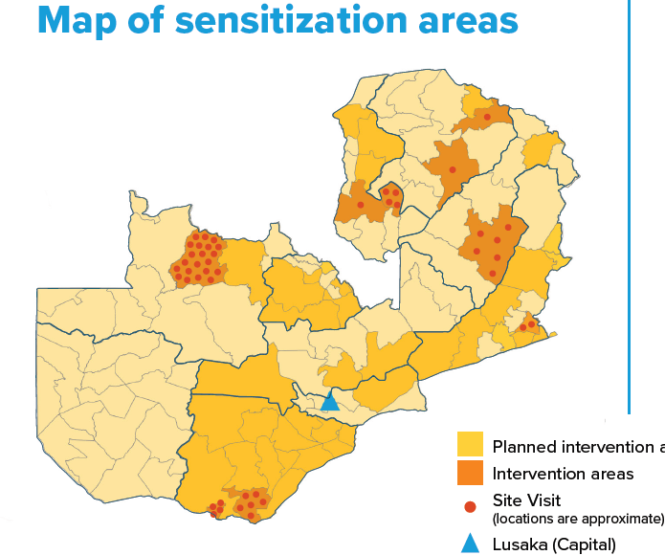
Identified sites geo-referenced
Sites Visited
Intervention areas
Planned

Slide 9
THANK YOU

